Slide 1

24CSA212 –
Full Stack Frameworks
Introduction to Node.js and npm

Slide 2
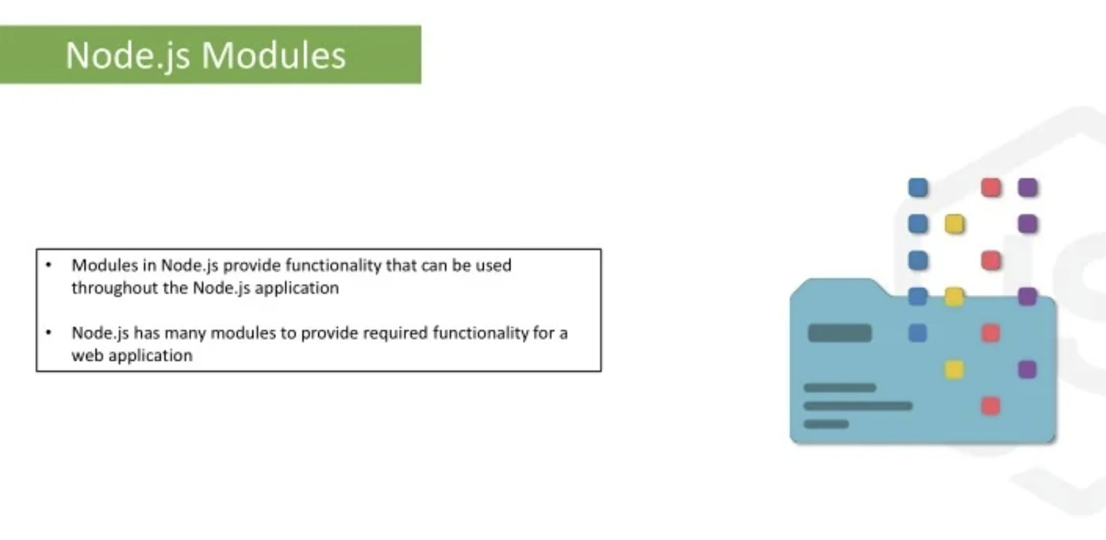

Slide 3
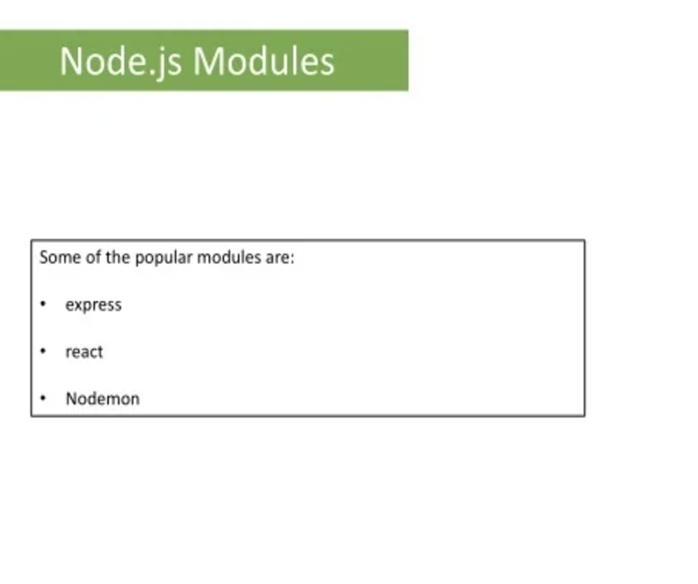




Slide 4
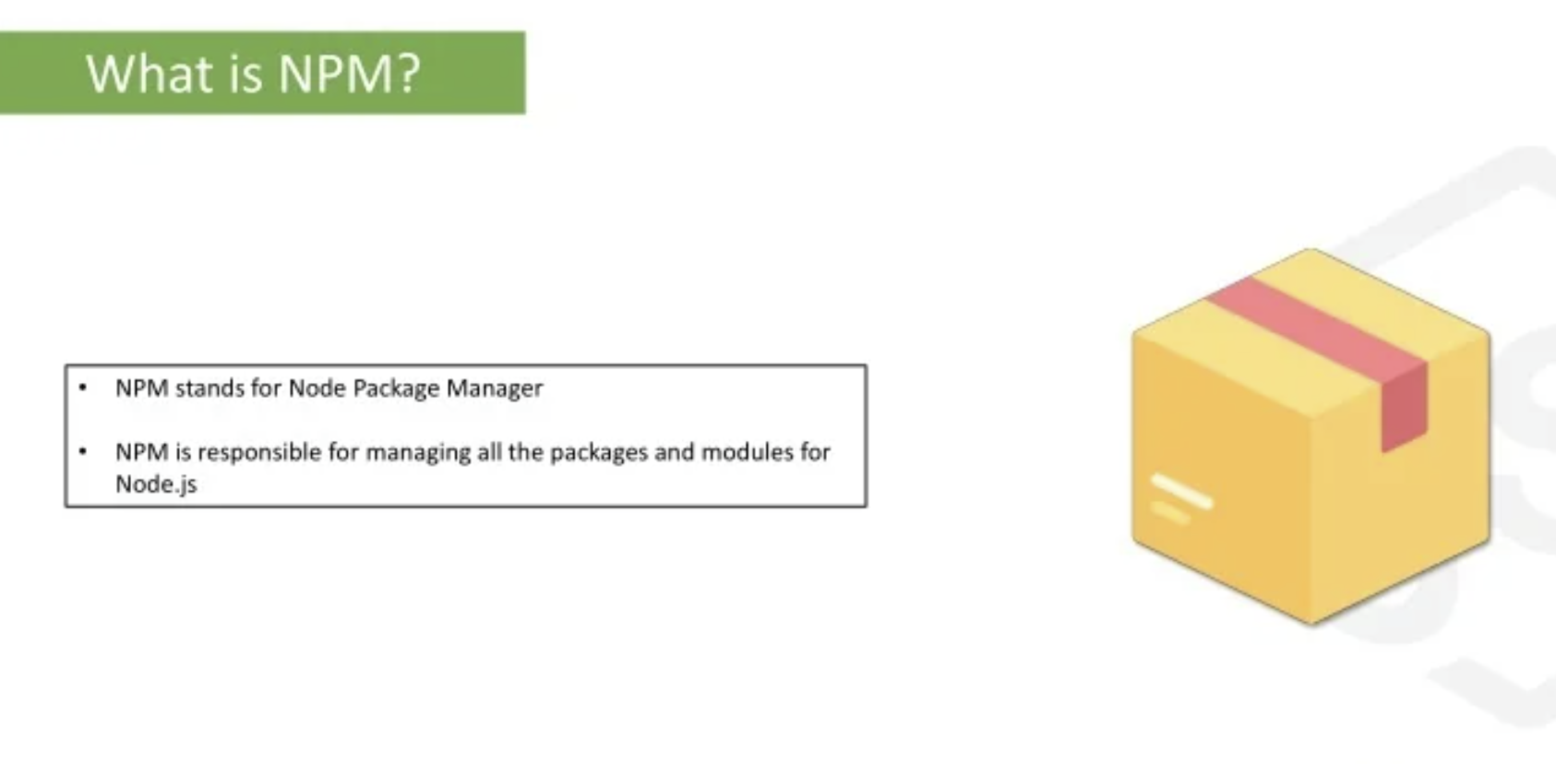

Slide 5
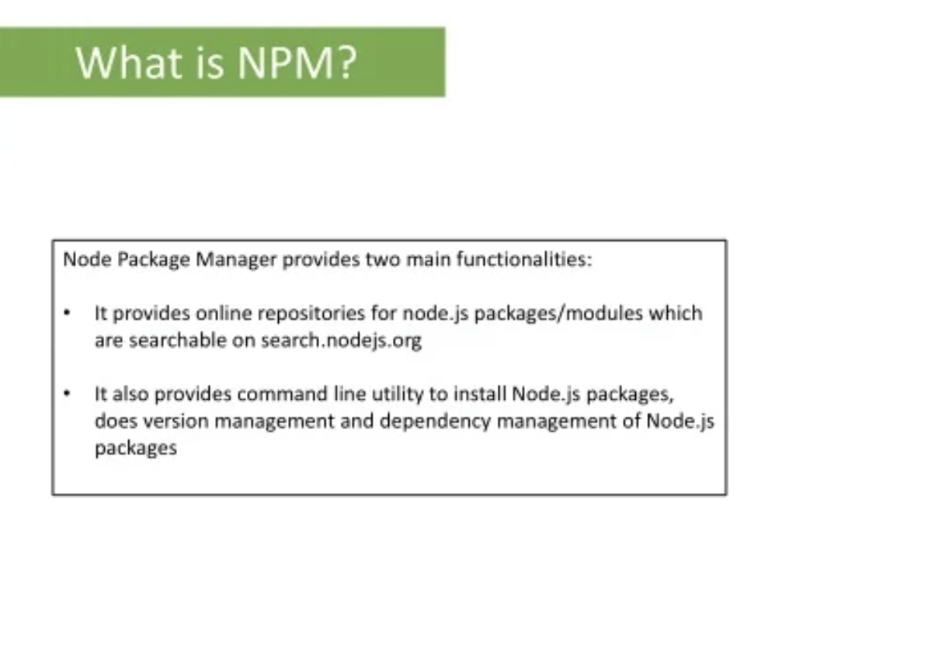
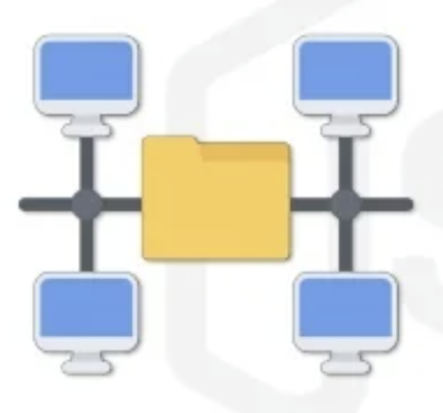
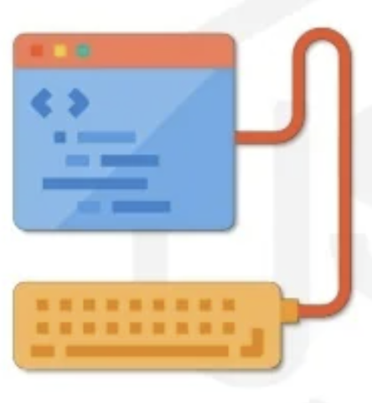

Slide 6
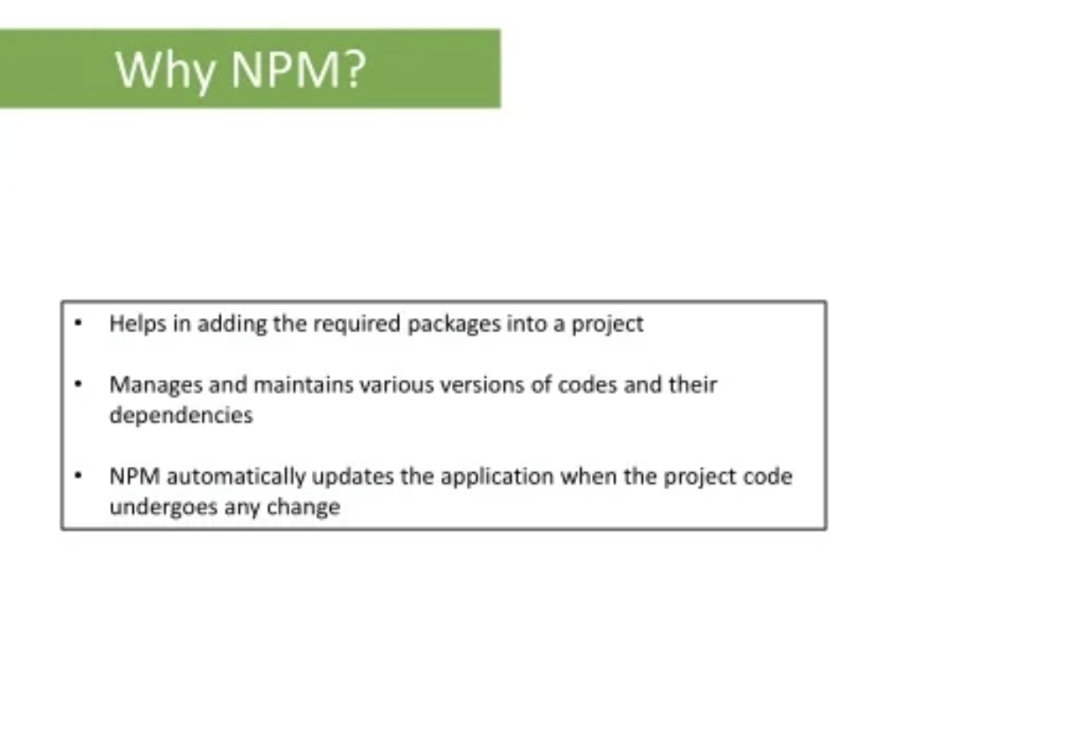

Slide 7
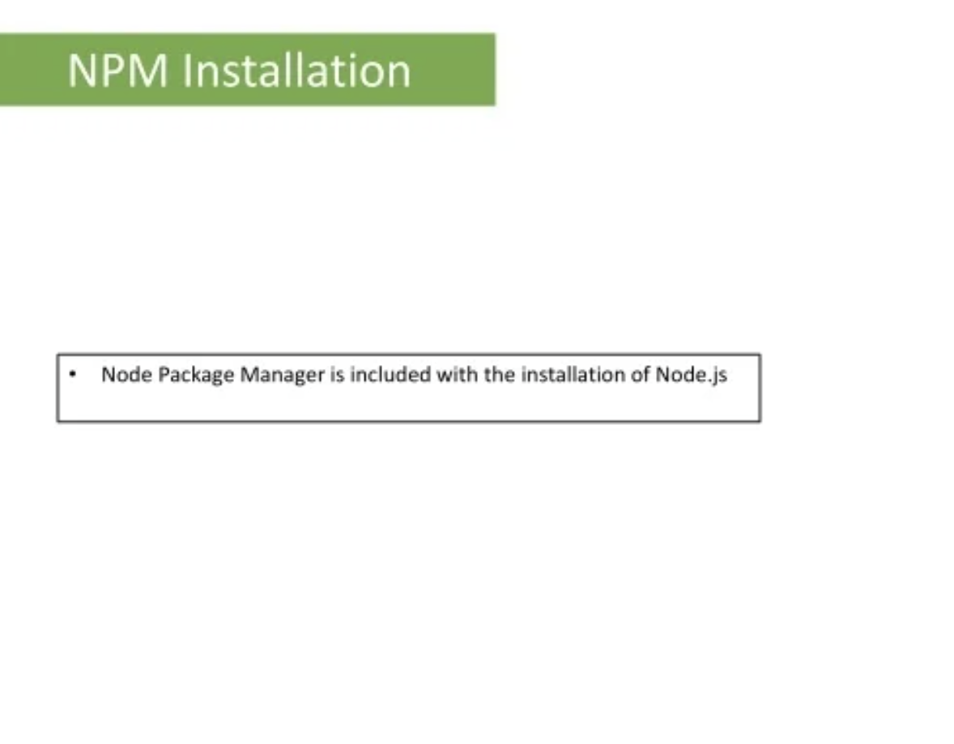

Slide 8
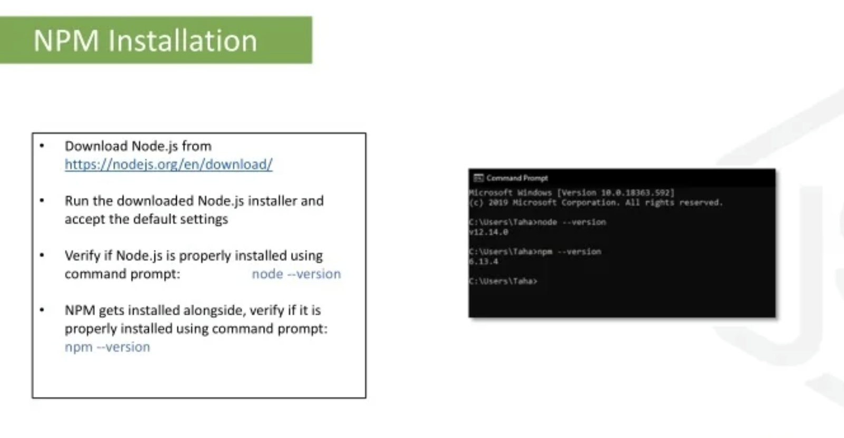

Slide 9
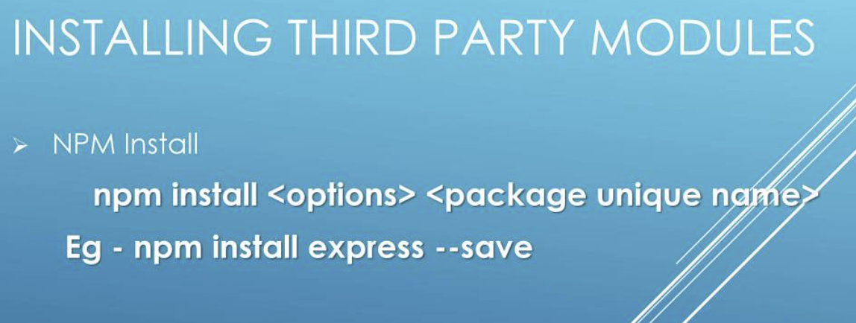

Slide 10
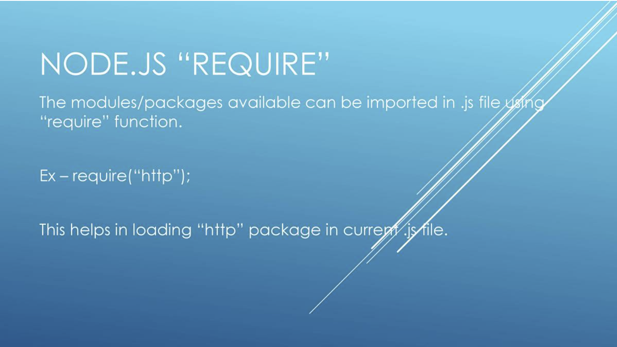

Slide 11
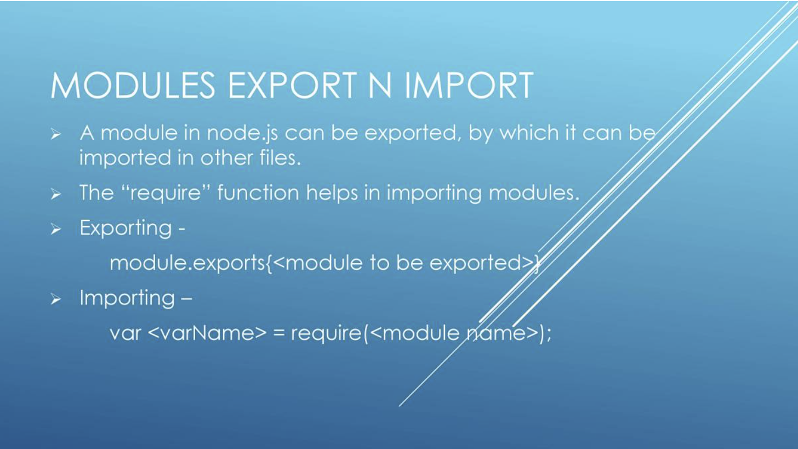

Slide 12
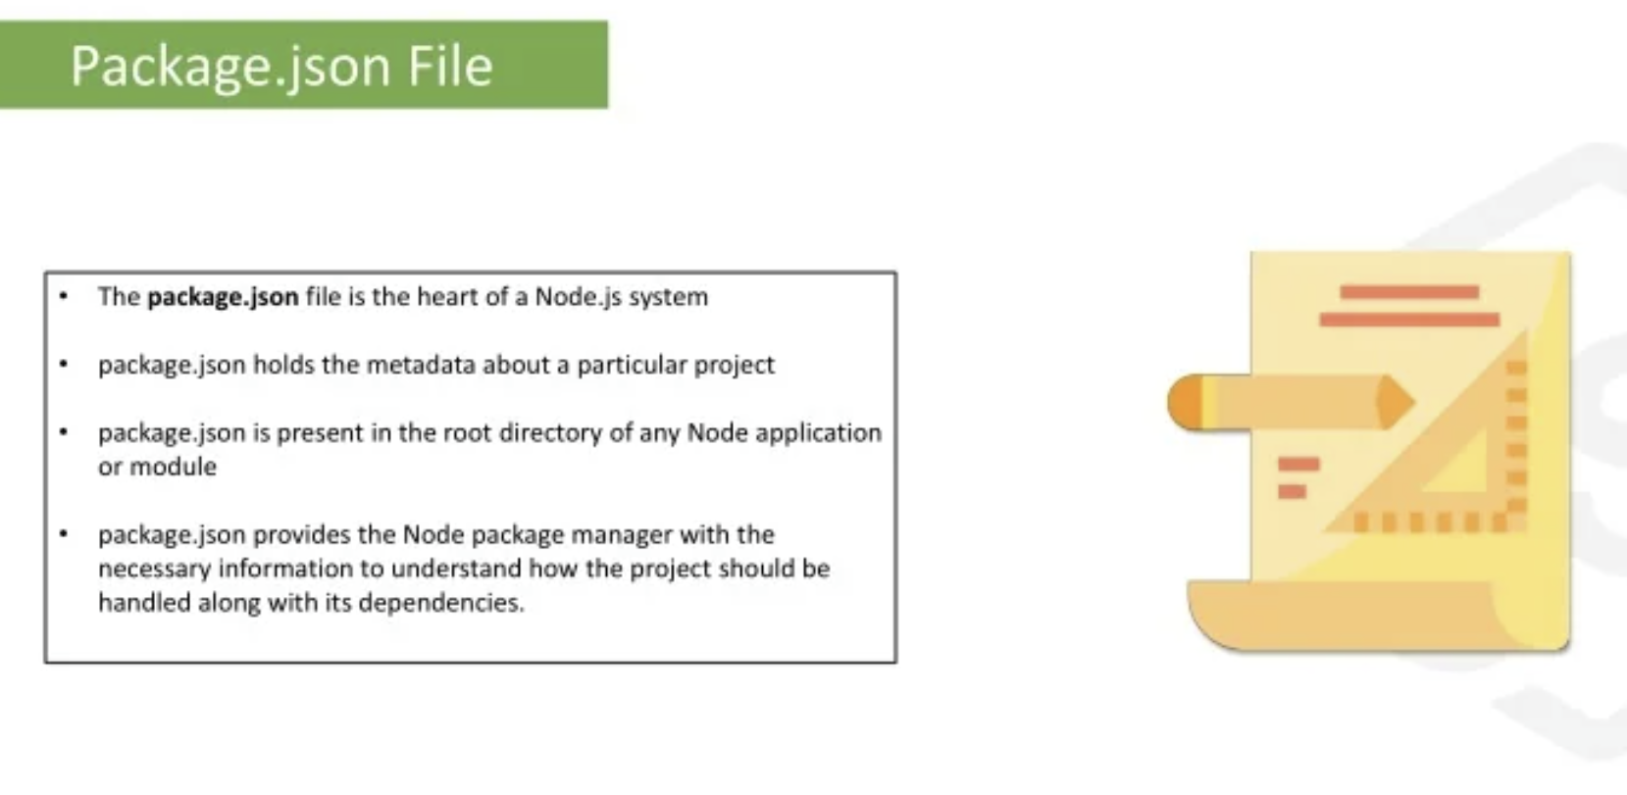

Slide 13
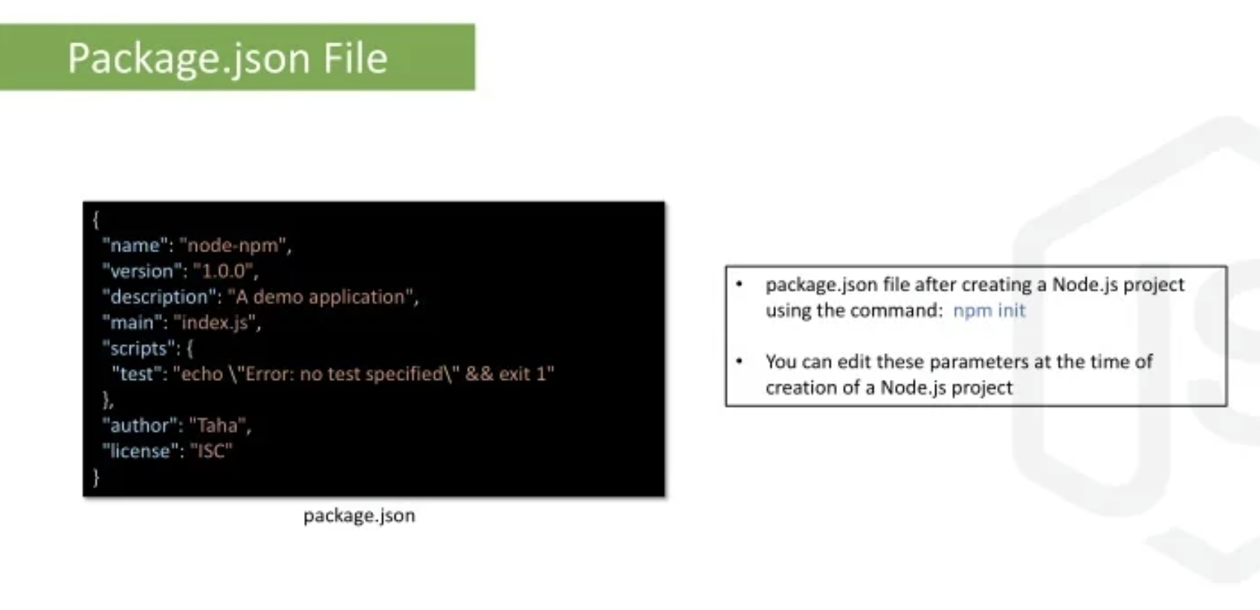

Slide 14
Explanation:name: The name of the application/project.
version: The version of application. The version should follow semantic versioning rules.
description: The description about the application, purpose of the application, technology used like React, MongoDB, etc.
main: This is the entry/starting point of the app. It specifies the main file of the application that triggers when the application starts. Application can be started using npm start.
scripts: The scripts which needs to be included in the application to run properly.
engines: The versions of the node and npm used. These versions are specified in case the application is deployed on cloud like heroku or google-cloud.
keywords: It specifies the array of strings that characterizes the application.
author: It consist of the information about the author like name, email and other author related information.
license: The license to which the application confirms are mentioned in this key-value pair.

Slide 15
dependencies: The third party package or modules installed using.
npm: are specified in this segment.
devDependencies: The dependencies that are used only in the development part of the application are specified in this segment. These dependencies do not get rolled out when the application is in production stage.
repository: It contain the information about the type and url of the repository where the code of the application lives is mentioned here in this segment.
bugs: The url and email where the bugs in the application should be reported are mentioned in this segment.
Note: Here, “body-parser”, “express”, “express-validator”, “mongoose” and “nodemon” are the modules/packages installed using npm (Node Package Manager).

Slide 16
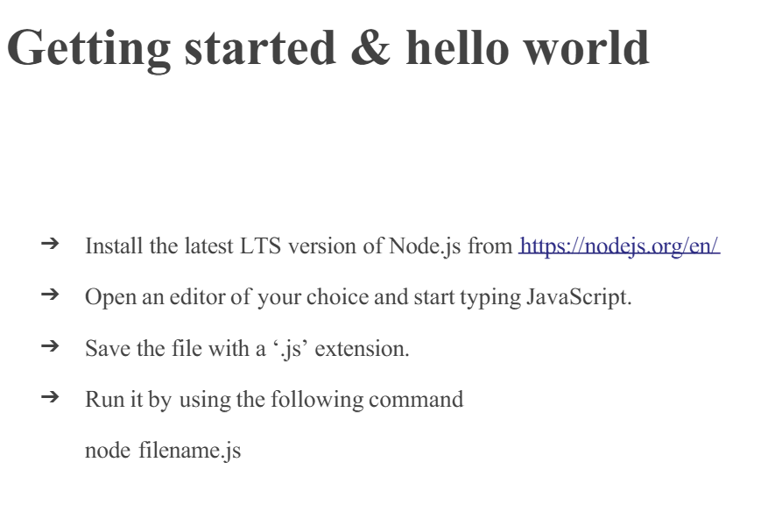

Slide 17
Node.js First Application
Console based Node.js Application: The Node.js console-based applications are run using Node.js command prompt.
The console.log() function is used to display output on console. This function prints output to stdout with newline.
console.log('Hello World');

Slide 18
Web-based Node.js Application: A web-based Node.js application consists of the following three important components:
Import required modules: Load Node.js modules using the require directive. Load http module and store returned HTTP instance into a variable.
Syntax: var http = require("http");
Create server: Create a server to listen the client’s requests. Create server instance using createServer() method. Bind server to port 8080 using listen method associated with server instance.
Syntax: http.createServer().listen(8080);
Read request and return response: Read the client request made using browser or console and return the response. A function with request and response parameters is used to read client request and return response.
Syntax:
http.createServer(function (request, response) {...}).listen(8080);

Slide 19
Run the file on Node.js command prompt using command node firstprogram.js and type http://127.0.0.1:8080/ in a web browser to see the output.

Slide 20
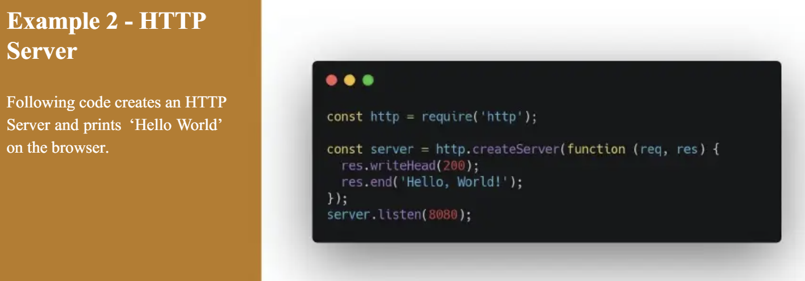

Slide 21
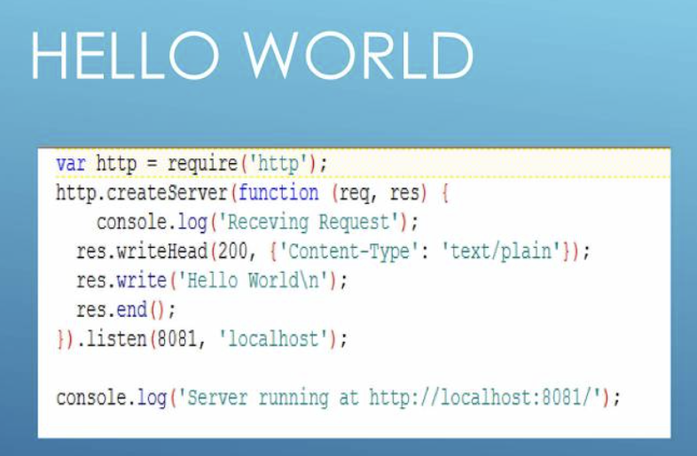

Slide 22
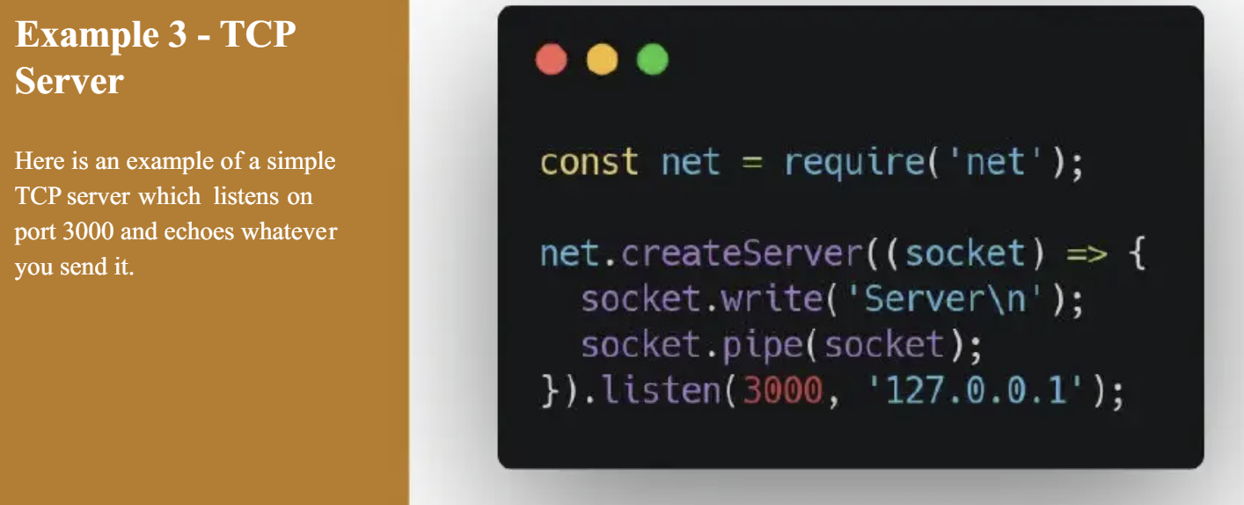

Slide 23
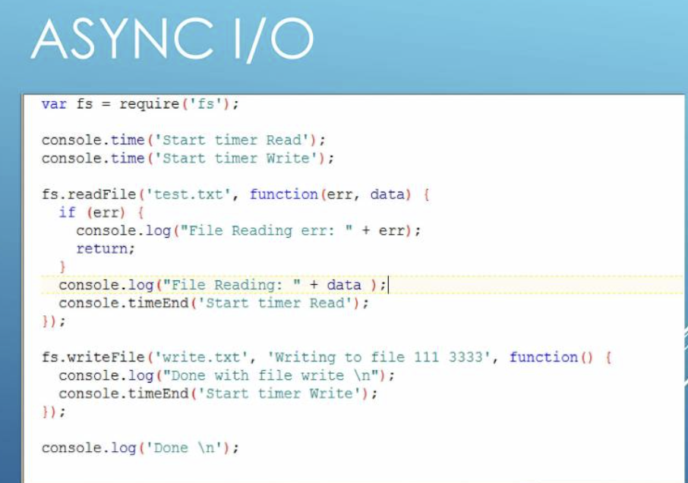

Slide 24
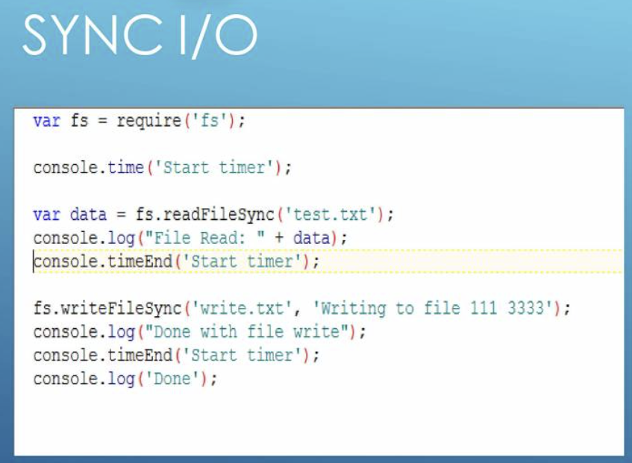

Slide 25
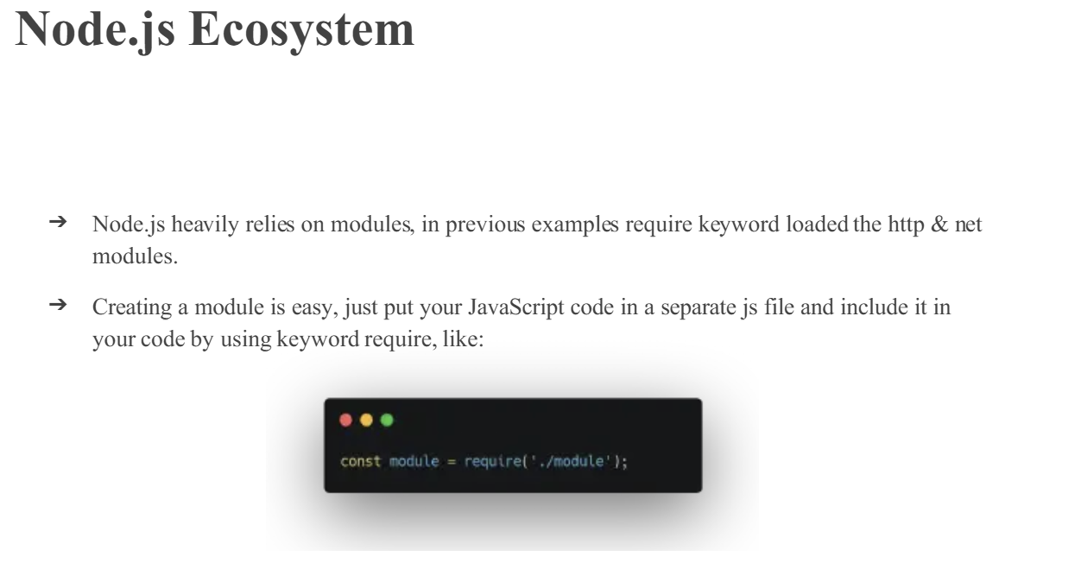

Slide 26
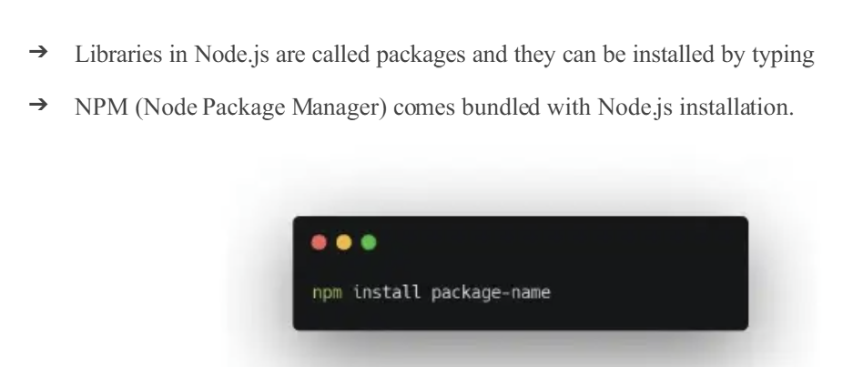

Slide 27
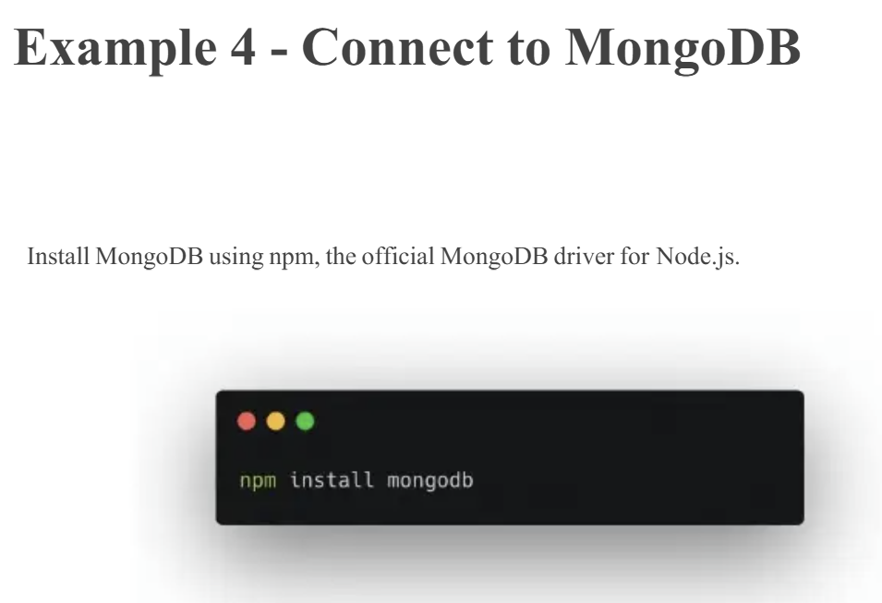

Slide 28
Datatypes:
Node.js contains various types of data types similar to JavaScript.
Boolean
Undefined
Null
String
Number

Slide 29
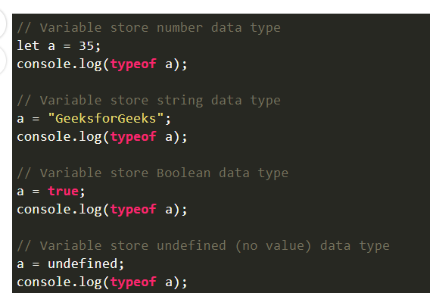
Loose Typing: Node.js supports loose typing, which means you don’t need to specify what type of information will be stored in a variable in advance. We use the var and let keywords in Node.js declare any type of variable.

Slide 30
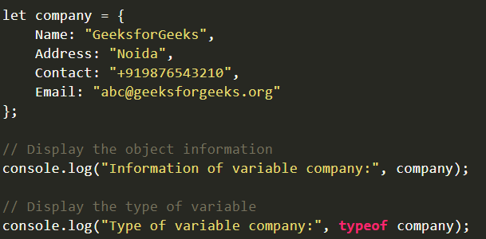
Objects & Functions: Node.js objects are the same as JavaScript objects i.e. the objects are similar to variables and it contains many values which are written as name: value pairs. Name and value are separated by a colon and every pair is separated by a comma.

Slide 31
Output:
Information of variable company: {
Name: 'GeeksforGeeks',
Address: 'Noida',
Contact: '+919876543210',
Email: 'abc@geeksforgeeks.org'
}
Type of variable company: object

Slide 32
Functions: Node.js functions are defined using the function keyword and then the name of the function and parameters which are passed in the function. In Node.js, we don’t have to specify datatypes for the parameters and check the number of arguments received. Node.js functions follow every rule which is there while writing JavaScript functions.

Slide 33
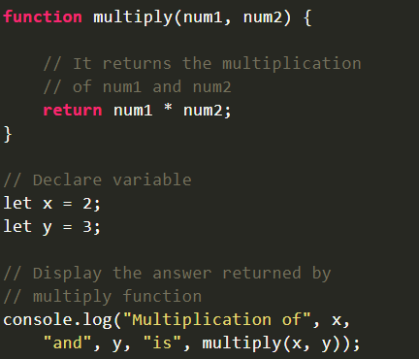

Slide 34
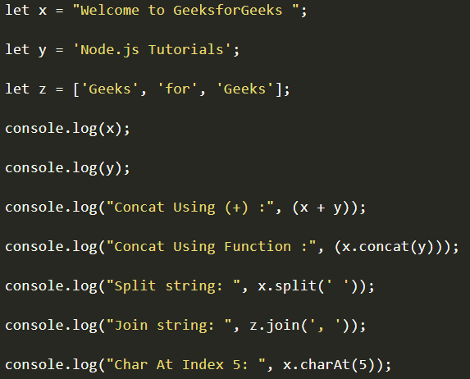
String and String Functions: In Node.js we can make a variable a string by assigning a value either by using single (”) or double (“”) quotes and it contains many functions to manipulate strings.

Slide 35
Output:
Welcome to GeeksforGeeks
Node.js Tutorials
Concat Using (+) : Welcome to GeeksforGeeks Node.js Tutorials
Concat Using Function : Welcome to GeeksforGeeks Node.js Tutorials
Split string: [ 'Welcome', 'to', 'GeeksforGeeks', '' ]
Join string: Geeks, for, Geeks
Char At Index 5: m

Slide 36
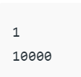
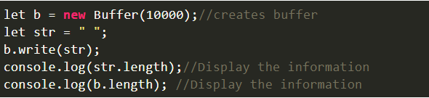
Buffer: In node.js, we have a data type called “Buffer” to store binary data and it is useful when we are reading data from files or receiving packets over the network.

Slide 37
Node.js - REPL Terminal
The Node.js interactive REPL terminal is like the Powershell or Command prompt terminal, or a bash terminal in Linux. It performs the following tasks −
Read − Reads user's input, parses the input into JavaScript data-structure, and stores in memory.
Eval − Takes and evaluates the data structure.
Print − Prints the result.
Loop − The terminal is ready to receive next input from the user.

Slide 38
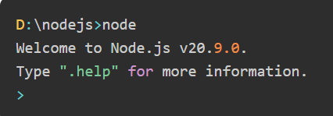
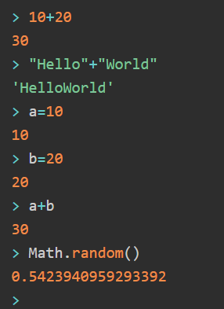
To start the Node.js REPL on your computer, simply enter node in the command terminal (without the javascript file name as done before). The Node.js prompt > will appear.

Slide 39
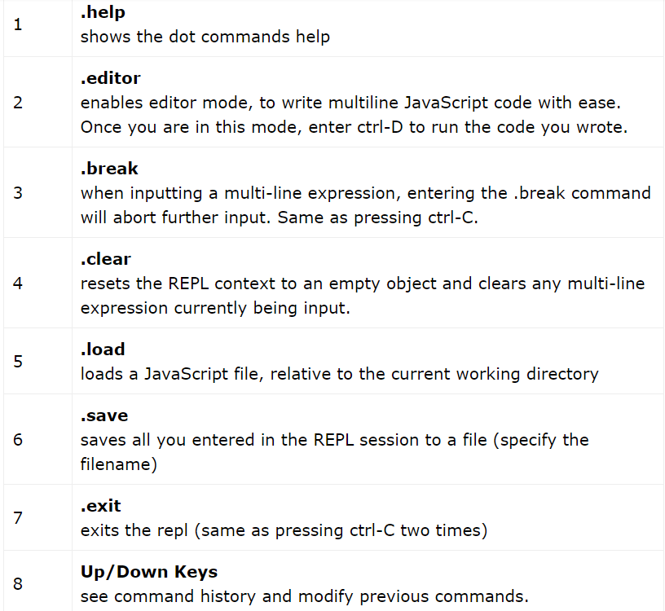

Slide 40
The browser:Javascript can execute one thing at a time but that’s not the case with the Browser. The Browser has its own set of APIs like setTimeout and XMLHttpRequests which are not specified in the Javascript runtime.
Heap: It’s mostly the place where objects are allocated.
Callback Queue: It’s a data structure that stores all the callbacks. Since it’s a queue, the elements are processed based on FIFO which is First in First Out.
Event Loop: This is where all these things come together. The event loop simply checks the call stack, and if it is empty (which means there are no functions in the stack) it takes the oldest callback from the callback queue and pushes it into the call stack which eventually executes the callback.

Slide 41
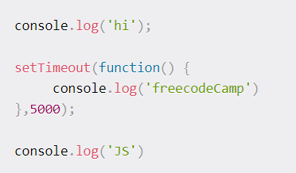

Slide 42
When the first line executes it’s a console.log().
This is a function invocation which means that this function is pushed into the call stack where it executes printing ‘hi’ to the console.
Finally it’s returned and is popped off the stack.
Then when the runtime goes to execute setTimeout() it knows that this is a web API.
Therefore it gives it off to the browser to handle its execution.
The browser starts the timer and then JS runtime pops the setTimeout() out of the stack.
It encounters another console.log() invocation and so it pushes this into the call stack, the message ‘JS’ is logged into the console, and then it’s finally returned.
Then the last console.log() is popped off the stack.
Now the call stack is empty.

Slide 43
Meanwhile while all of this was going on the timer finishes. When 5 seconds have elapsed the browser goes ahead and pushes the callback function into the callback queue.
Next the event loop checks if the call stack is free or not. Since it is free it takes the callback function and pushes it again back to the call stack which executes the code inside it.
Again inside the code there is a console.log() invocation so this function goes to the top of the stack executes which logs ‘freecodecamp’ into the console and finally it returns. This means it gets popped off the stack and finally the callback gets popped off the stack and we are done.

Slide 44
Node.js Event Loop
Node.js is a single-threaded event-driven platform that is capable of running non-blocking, asynchronous programming. These functionalities of Node.js make it memory efficient. The event loop allows Node.js to perform non-blocking I/O operations despite the fact that JavaScript is single-threaded. It is done by assigning operations to the operating system whenever and wherever possible.
Most operating systems are multi-threaded and hence can handle multiple operations executing in the background. When one of these operations is completed, the kernel tells Node.js, and the respective callback assigned to that operation is added to the event queue which will eventually be executed.

Slide 45
Features of Event Loop:
An event loop is an endless loop, which waits for tasks, executes them, and then sleeps until it receives more tasks.
The event loop executes tasks from the event queue only when the call stack is empty i.e. there is no ongoing task.
The event loop allows us to use callbacks and promises.
The event loop executes the tasks starting from the oldest first.

Slide 46
console.log("This is the first statement");
setTimeout(function(){
console.log("This is the second statement");
}, 1000);
console.log("This is the third statement");

Slide 47
Output:
This is the first statement
This is the third statement
This is the second statement

Slide 48
Explanation:
In the above example, the first console log statement is pushed to the call stack, and “This is the first statement” is logged on the console, and the task is popped from the stack.
Next, the setTimeout is pushed to the queue and the task is sent to the Operating system and the timer is set for the task.
This task is then popped from the stack. Next, the third console log statement is pushed to the call stack, and “This is the third statement” is logged on the console and the task is popped from the stack.
When the timer set by the setTimeout function (in this case 1000 ms) runs out, the callback is sent to the event queue.
The event loop on finding the call stack empty takes the task at the top of the event queue and sends it to the call stack.
The callback function for the setTimeout function runs the instruction and “This is the second statement” is logged on the console and the task is popped from the stack.

Slide 49
Working of the Event loop: When Node.js starts, it initializes the event loop, processes the provided input script which may make async API calls, schedules timers, then begins processing the event loop. In the previous example, the initial input script consisted of console.log() statements and a setTimeout() function which schedules a timer.
When using Node.js, a special library module called libuv is used to perform async operations.
This library is also used, together with the back logic of Node, to manage a special thread pool called the libuv thread pool.
This thread pool is composed of four threads used to delegate operations that are too heavy for the event loop. I/O operations, Opening and closing connections, setTimeouts are examples of such operations.

Slide 50
When the thread pool completes a task, a callback function is called which handles the error(if any) or does some other operation.
This callback function is sent to the event queue.
When the call stack is empty, the event goes through the event queue and sends the callback to the call stack.

Slide 51
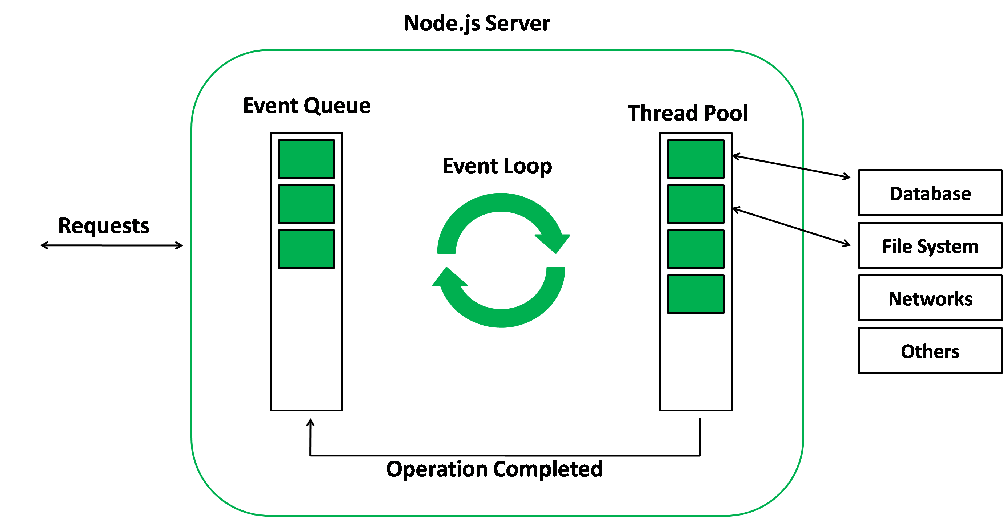
The following diagram is a proper representation of the event loop in a Node.js server:

Slide 52
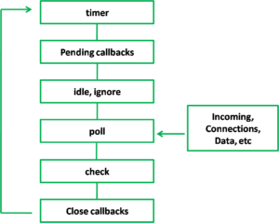
Phases of the Event loop: The event loop in Node.js consists of several phases, each of which performs a specific task. These phases include:

Slide 53
1. Timers: This phase processes timers that have been set using setTimeout() and setInterval().
console.log('Start');
setTimeout(() => {
console.log('Timeout callback');
}, 2000);
console.log('End');

Slide 54
In this example, the setTimeout() function is called with a callback that will print “Timeout callback” to the console after 2000 milliseconds (2 seconds). This function is added to the message queue in the timers phase, and the event loop will process it after the synchronous code is executed.
The output will be:
Start
End
Timeout callback
As you can see, the “Timeout callback” is printed after 2 seconds, after the “Start” and “End” are printed, because the setTimeout() function is non-blocking and its callback is processed by the event loop after the execution of the synchronous code.

Slide 55
2. Pending Callbacks: This phase processes any callbacks that have been added to the message queue by asynchronous functions.
console.log('Start');
setImmediate(() => {
console.log('Immediate callback');
});
console.log('End');

Slide 56
In this example, the setImmediate() function is called with a callback that will print “Immediate callback” to the console.
This function is added to the message queue in the pending callbacks phase, and the event loop will process it after the timers phase.
The output will be:
Start
End
Immediate callback

Slide 57
3. Idle, Prepare: The “idle.ignore” phase is not a standard phase of the event loop in Node.js.
It means it’s Used internally only.
The “idle” phase is a period of time during which the event loop has nothing to do and can be used to perform background tasks, such as running garbage collection or checking for low-priority events.
const { idle } = require('idle-gc');
idle.ignore();

Slide 58
4. Poll: This phase is used to check for new I/O events and process any that have been detected.
const fs = require('fs');
const readStream = fs.createReadStream('./file.txt');
console.log('Start');
readStream.on('data', (chunk) => {
console.log(chunk.toString());
});
console.log('End’);
In this example, a readStream is created to read the contents of a file. The ‘data’ event is added to the message queue in the poll phase, and the event loop will process it after the pending callbacks phase. The output will be the content of the file.

Slide 59
5. Check This phase processes any setImmediate() callbacks that have been added to the message queue.
console.log('Start');
setImmediate(() => {
console.log('Immediate callback');
});
console.log('End’);
In this example, the setImmediate() function is called with a callback that will print “Immediate callback” to the console.
This function is added to the message queue in the check phase, and the event loop will process it after the poll phase.
The output will be:
Start
End
Immediate callback

Slide 60
6. Close Callbacks: This phase processes any callbacks that have been added to the message queue by the close event of a socket. This means that any code that needs to be executed when a socket is closed is placed in the message queue and processed during this phase.
const net = require('net');
const server = net.createServer((socket) => {
socket.on('close', () => {
console.log('Socket closed');
});
});
server.listen(8000);

Slide 61
In this example, a server is created using the net module, and the ‘close’ event is added to the message queue in the close callbacks phase with a callback that will print “Socket closed” to the console.
This event will be triggered when the server’s socket is closed by the client and the callback will be processed by the event loop during the close callbacks phase.
It’s important to note that the order of execution of these phases can vary depending on the specific implementation of the event loop, but generally, the event loop will process them in the order mentioned above.
Each phase is executed in order, and the event loop will continue to cycle through these phases until the message queue is empty.

Slide 62
Conclusion:
The event loop is a powerful feature of Node.js that enables it to handle a high number of concurrent connections and perform non-blocking I/O operations.
Understanding how the event loop works is essential for building efficient and performant server-side applications in Node.js.
With a better understanding of the event loop, developers can take full advantage of the capabilities of Node.js and build high-performance, scalable applications.

Slide 63
Node Callback
A callback in Node is a non-blocking function that executes upon task completion, enabling asynchronous processing. It facilitates scalability by allowing Nodejs to handle multiple requests without waiting for operations to conclude.

Slide 64
Building Http Server
Creating Web Servers Using NodeJS: There are mainly two ways as follows.
Using http inbuilt module
Using express third party module

Slide 65
Using http module: HTTP and HTTPS, these two inbuilt modules are used to create a simple server.
The HTTPS module provides the feature of the encryption of communication with the help of the secure layer feature of this module.
Whereas the HTTP module doesn’t provide the encryption of the data.

Slide 66
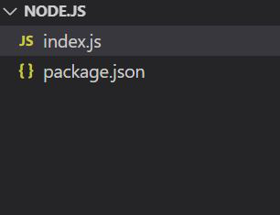
Project structure: It will look like this.

Slide 67
// Importing the http module
const http = require("http")
// Creating server
const server = http.createServer((req, res) => {
// Sending the response
res.write("This is the response from the server")
res.end();
})
// Server listening to port 3000
server.listen((3000), () => {
console.log("Server is Running");
})

Slide 68
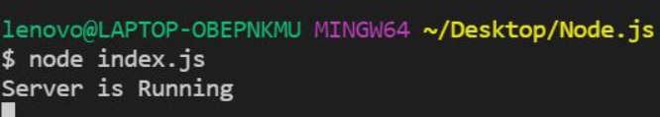
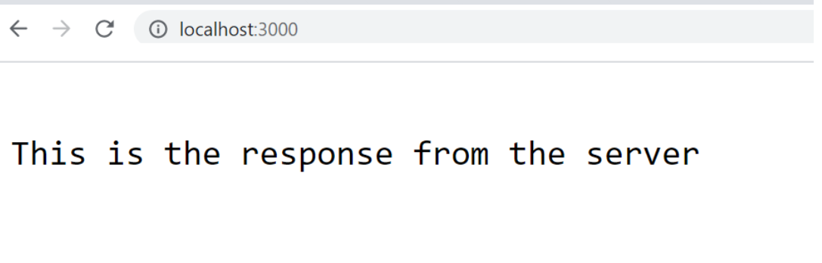
Run index.js file using below command:node index.js
Now open your browser and go to http://localhost:3000/, you will see the following output:

Slide 69
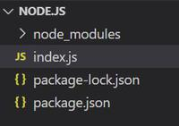
Using express module: The express.js is one of the most powerful frameworks of the node.js that works on the upper layer of the http module. The main advantage of using express.js server is filtering the incoming requests by clients.
Installing module: Install the required module using the following command.
npm install express
Project structure: It will look like this.

Slide 70
// Importing express module
const express = require("express")
const app = express()
// Handling GET / request
app.use("/", (req, res, next) => {
res.send("This is the express server")
})
// Handling GET /hello request
app.get("/hello", (req, res, next) => {
res.send("This is the hello response");
})
// Server setup
app.listen(3000, () => {
console.log("Server is Running")
})

Slide 71
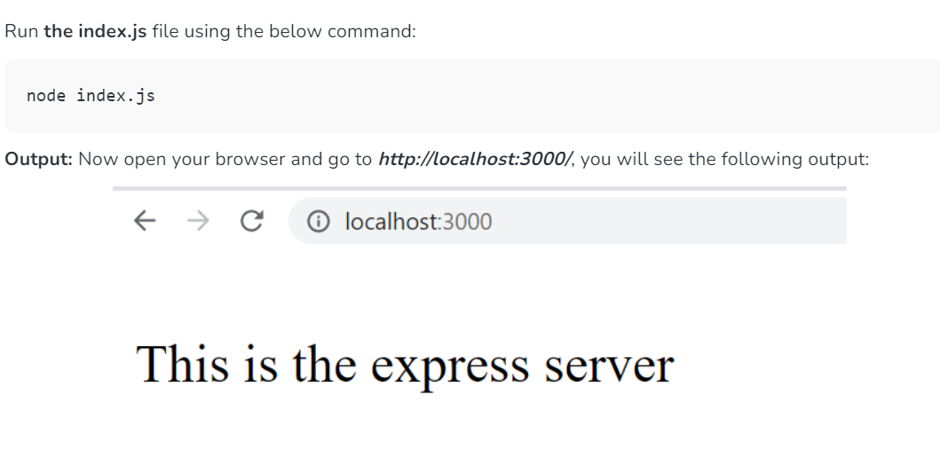

Slide 72
app. get() is a function that tells the server what to do when a get request at the given route is called.
The app.use() function is used to mount the specified middleware function(s) at the path that is being specified.
app. get is called when the HTTP method is set to GET , whereas app. use is called regardless of the HTTP method, and therefore defines a layer which is on top of all the other RESTful types which the express packages gives you access to

Slide 73
Import and Export in Node.js
In programming, modules are components of a program with one or more functions or values.
These values can also be shared across the entire program and can be used in different ways.
Why Export Modules?
we use them in other parts of your application.
Modules can serve different purposes. They can provide simple utilities to modify strings. They can provide methods for making API requests. Or they can even provide constants and primitive values.
When you export a module, you can import it into other parts of your applications and consume it.

Slide 74
Node.js supports CommonJS Modules and ECMAScript Modules.
How to Export Modules in Node
Node.js already exports in-built modules which include fs, path, and http to name a few. But you can create your own modules.
Node.js treats each file in a Node project as a module that can export values and functions from the file.

Slide 75
module.exports vs exports in Node
You can export functions and values from a module by either using module.exports:
module.exports = { value1, function1 }
or by using exports:
exports.value1 = value1
exports.function1 = function1

Slide 76
These methods are pretty identical. Basically, exports serves as a reference to module.exports.
Each file in a Node.js project is treated as a module that can export values to be used by other modules.
module.exports is an object in a Node.js file that holds the exported values and functions from that module.
Declaring a module.exports object in a file specifies the values to be exported from that file. When exported, another module can import this values with the require global method.

Slide 77
Steps to include functions from other files:
Creating a Module: Modules are created in Node.js are JavaScript files. Every time a new file with .js extension is created, it becomes a module.
Exporting a Module: Filename: func.js
function add(x, y) {
return x + y;
}
function subtract(x, y) {
return x - y;
}
// Adding the code below to allow importing
// the functions in other files
module.exports = { add }

Slide 78
Importing a Module: We need to import the module to use the functions defined in the imported module in another file. The result returned by require() is stored in a variable which is used to invoke the functions using the dot notation. Filename: main.js
// Importing the func.js module
// The ./ says that the func module is in the same directory as the main.js file
// const f = require('./func');
// Require returns an object with add() and stores it in the f variable which is used to invoke the required
const result = f.add(10, 5);
console.log('The result is:', result);

Slide 79
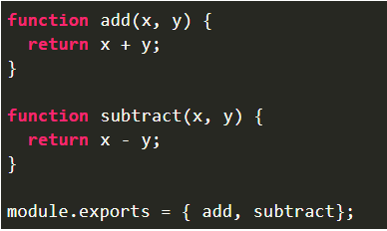
Importing multiple functions from local file: Filename: func.js

Slide 80
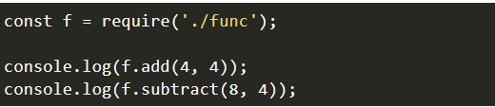
Filename: main.js

Slide 81
There are three types of modules in Node.js
Importing from local module:
These modules are created by the user and can be imported as:
const var = require('./filename.js'); // OR
const var = require('./path/filename.js');

Slide 82
Importing from core modules:
These modules are inbuilt in Node.js and can be imported as:
const var = require('fs');

Slide 83
Importing from third party modules:
These modules are installed using a package manager such as npm.
Examples of third party modules are express, mongoose, nodemon, etc.
These are imported as:
const express = require('express');

Slide 84
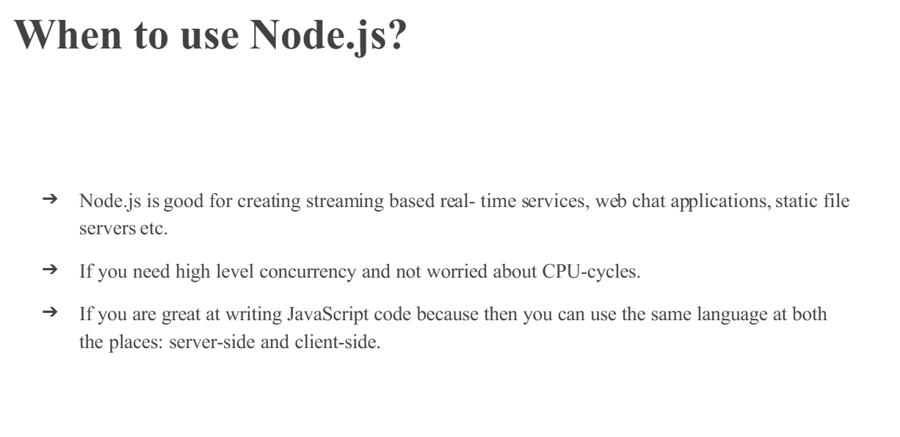

Slide 85


